Slide 2
Absence of Copyright
This slideshow contains photos, diagrams, and information, some of which were attained through internet searches of public websites. The author of this presentation does not own the copyright on this information, so this slideshow is for personal use only—not for sale or profit. Please utilize it to seek the Lord and grow in your knowledge of His Word and ways.
Bro Stan’s Revelation Study is available on our church website:
www.faithprinceton.org

Slide 4
Prayer and Announcements
Sundays Facebook Live or In-person:
9:15 Small Group Sunday School Classes
Greg Bowers teaches on Facebook Live
10:30 Worship (Facebook or YouTube)
Mask in and Mask out...

Slide 5
BEGINNING NEXT WEEK:
Notes:
Local Prayers:
Pray for church and our mission to share the Gospel... Vision for post Covid-19 ministry
Coronavirus illnesses: Jamie, Saucedas (especially Beto), Tommy Stapleton’s mom, Julie’s friend etc.
PRAISE: Lamar and Mary’s daughter Kathy and family doing well
Charles McAnally’s uncle passed away from sudden heart attack
Cindy Smith: slow healing of leg.... What to do about neck
Lindsey health issues

Slide 6
Many of you know Greg from watching him teach Sunday School on Facebook Live each week.
Notes:
Local Prayers:
Pray for church and our mission to share the Gospel... Vision for post Covid-19 ministry
Youth Minister search team interview
I’m going to step over to the Youth Gathering during the next few weeks, maybe months for support
Begin opening the gym for them to hang out at 5:30 pm
Need another adult who can take temps and be there as a support

Slide 7
Notes:
Pray for nation, church, youth, Gospel!

Slide 8
BEGIN HERE January 27, 2021
Week 34 – Revelation
Final Thoughts

Slide 9
CONCLUSIONS from the Book of REVELATION
Thinking about where we started...

Slide 10
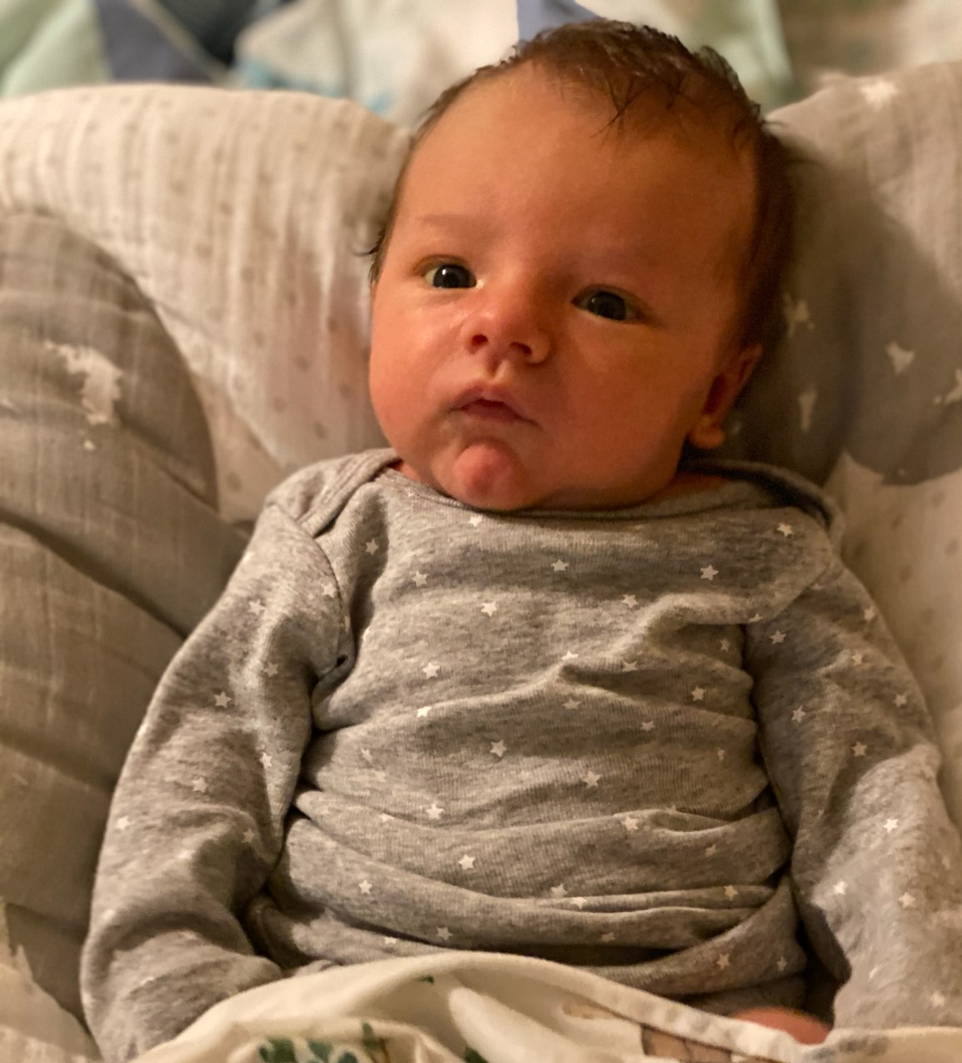
The first photo of my grandson Noah...
One month old!

Slide 11
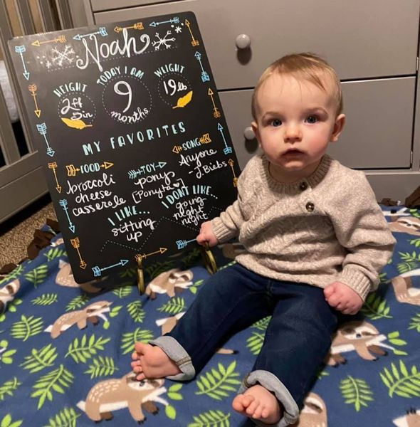
The latest photo of Noah...
Now 9 months old!!!

Slide 12
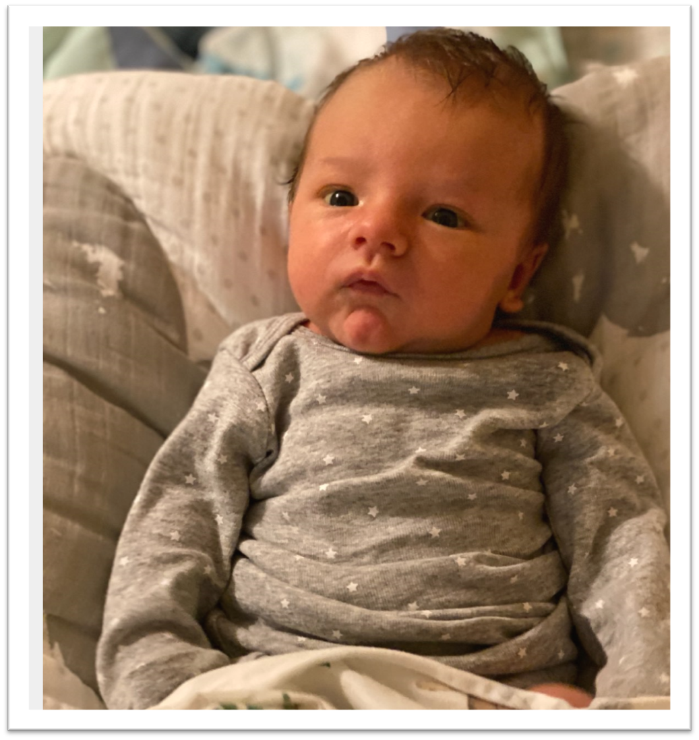
WHAT A CHANGE!!!

Slide 13
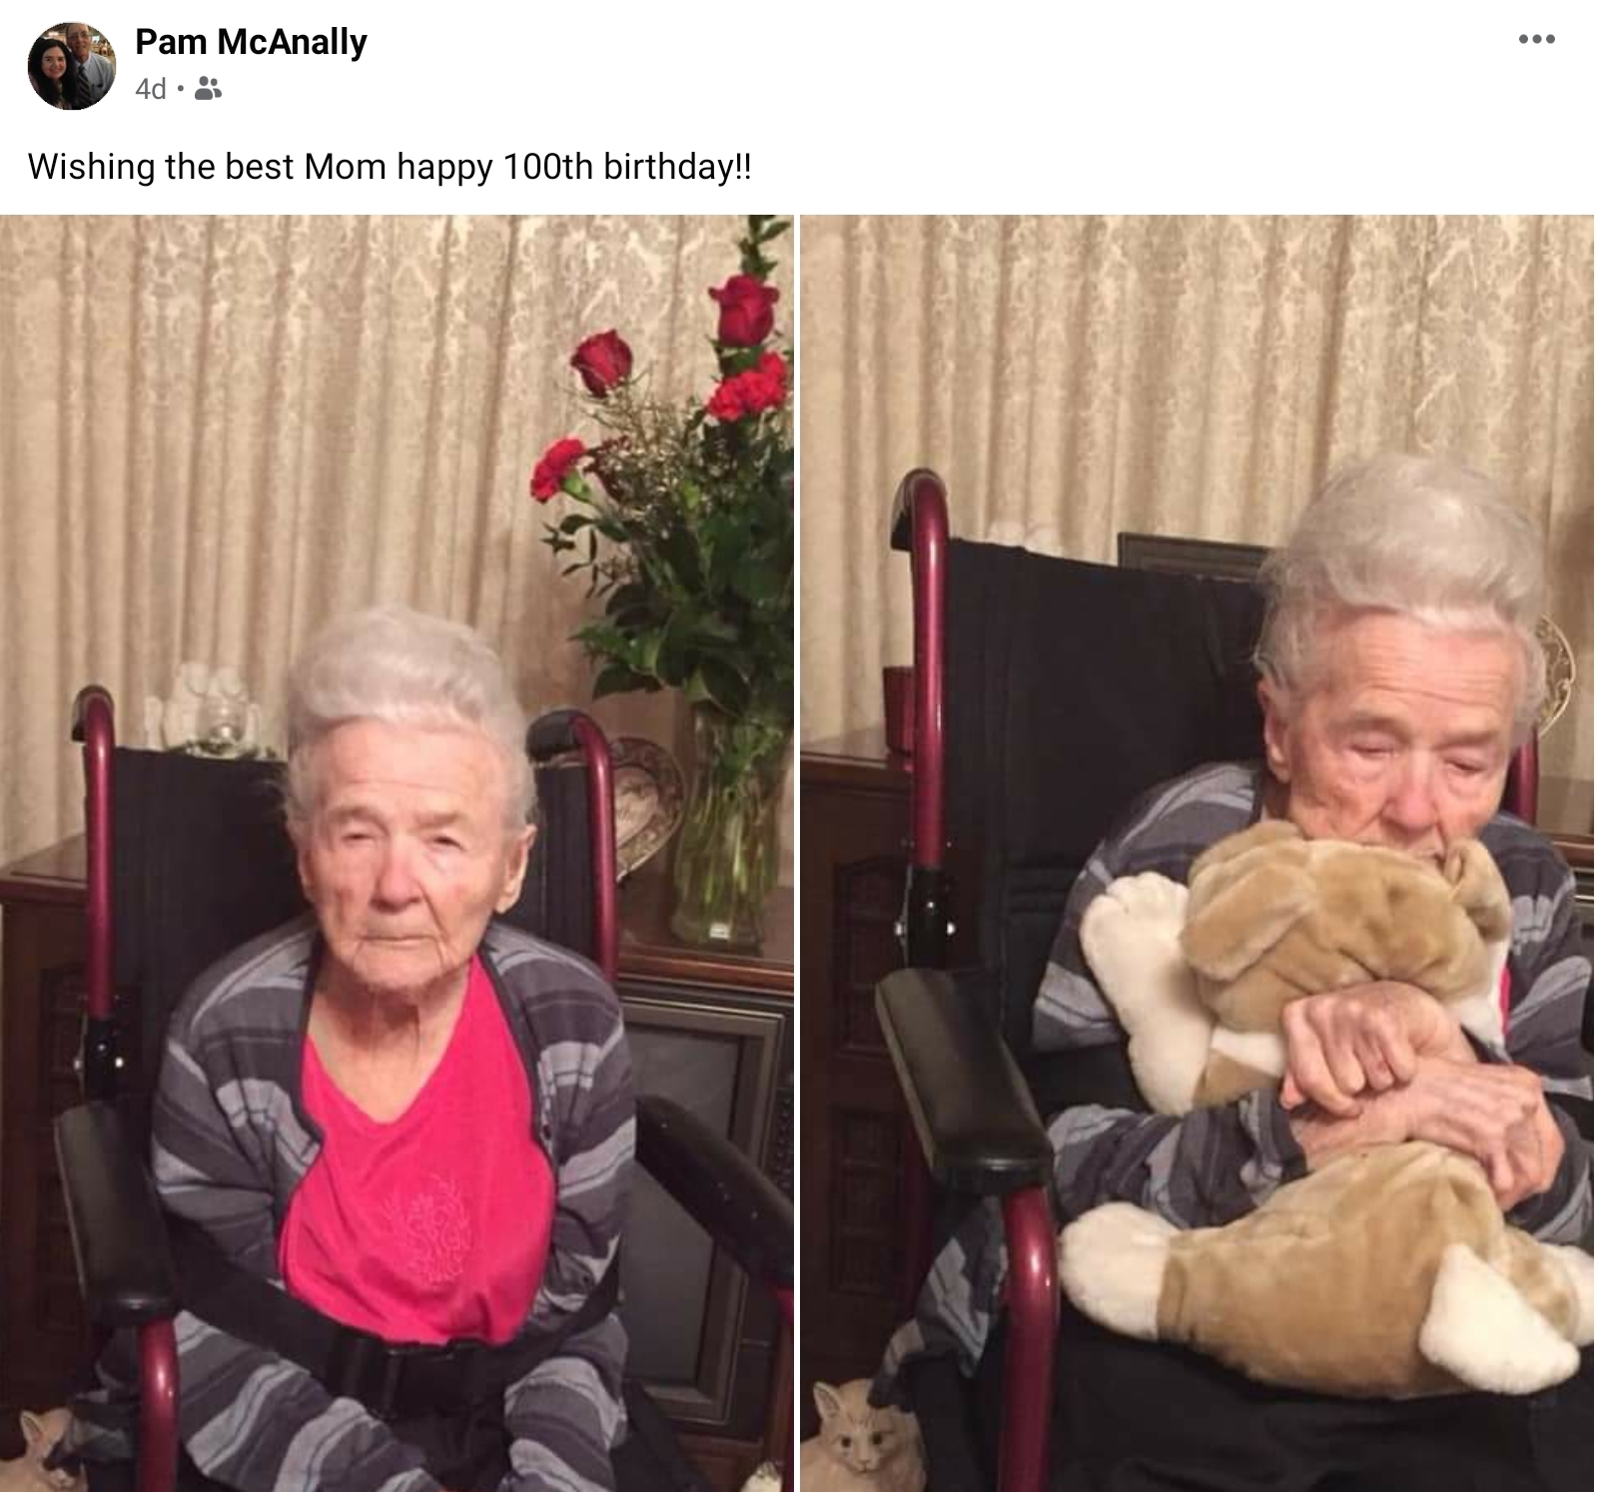
Noah is not the only one with MILESTONES...
As of yesterday, Minnie Faye Griffin celebrated her 1,200th month!!!
Notes:
Jan 25, 2021 ➔ 100th Birthday!!!

Slide 14
WHAT AN AMAZING LADY!!!
Notes:
She and husband Wylie, loved the Lord, served the Lord, worshipped the Lord, and instilled His righteousness into multiple generations.
Praise the Lord.

Slide 15
First Read-through
Notes:
I asked everyone to do a straight read through and write down your thoughts.... Here were mine at the time.

Slide 16
First Read-through

Slide 17
First Read-through

Slide 18
First Read-through
Notes:
James Smith first read:
Revelation 5 things God spoke to me in reading today: 1) Those in Christ are still weak in flesh needing to consistently repent and focus on Jesus Christ 2) Power only comes from God, and there is great power in prayer throughout time 3) Many will cling to self, sin, and created things over God no matter what 4) Judgement must happen for paradise to be, and those of hate or love will meet their fate from which they choose 5) Sin purged and final Eden - paradise will come. God is true to His Word which never changes James E. Smith May 13, 2020
Not as fast a reader as you 1 hour and 15 minutes without stopping.

Slide 19
Purpose of Revelation
Revelation Completes the Gospel …
Devotional By Michael Youssef, Ph.D.
Revelation completes our understanding of God’s purpose for history and for our future.
Revelation shows us the danger of compromise and the ultimate destruction of Satan and those who reject Christ.
Revelation gives us an awe-inspiring portrait of the glorified, soon-coming King Jesus.
Notes:
Revelation Completes the Gospel
By Michael Youssef, Ph.D.
The word revelation has an important meaning: the manifestation or unveiling of something that has been hidden. In other words, the book of Revelation is the unveiling of God’s plan for the future.
God revealed this plan to John when he was in his 90s, exiled to the island of Patmos. Through John’s exile, God gifted John and His people with the most powerful heavenly vision for all of eternity: the Revelation of Jesus Christ. This vision completes the Gospel, giving hope to, sternly warning, and deeply comforting all those who trust in Jesus. As you read it, remember these three purposes of Revelation:
Revelation completes our understanding of God’s purpose for history and for our future. Revelation assures us that, while the world may look out of control, it’s not out of the control of God; He holds His children in His loving hand. From Genesis to Revelation, God has a plan, and Jesus is at the center of it all.
Revelation shows us the danger of compromise and the ultimate destruction of Satan and those who reject Christ. In Revelation we see that God has secured the victory, and judgment will come at the end times. Therefore we must not compromise, but stand firm against the spirit of this age, who says we can have salvation without the Savior, power without prayer, spirituality without the Holy Spirit, and morality without the Bible.
Revelation gives us an awe-inspiring portrait of the glorified, soon-coming King Jesus. John’s vision completes the Gospel of salvation -- past, present, and future. For in Revelation we see Jesus no longer hanging on a cross, but glorified in white and gold, with hair white as wool, with eyes that blaze with fire, with a voice like rushing waters (see Revelation 1:13-15). We see Jesus as the Alpha and the Omega, the beginning and the end (22:13).

Slide 20
Revelation – Introduction – Revelation 1:1-3
1 The Revelation of Jesus Christ, which God gave Him to show to His bond-servants, the things which must soon take place; and He sent and communicated it by His angel to His bond-servant John, ² who testified to the word of God and to the testimony of Jesus Christ, even to all that he saw.
³ Blessed is he who reads and those who hear the words of the prophecy, and heed the things which are written in it; for the time is near.

Slide 21
FINAL THOUGHTS...
Notes:
A QUICK SUMMARY OF SOME OF THE THINGS I LEARNED OR STOOD OUT FOR ME IN OUR STUDY!
TRYING TO CRAM 34 WEEKS OF STUDY INTO THE NEXT 34 MINUTES!!! BUCKLE UP, BUTTERCUP!

Slide 22
Notes:
WHERE WE’VE BEEN IN SUMMARY

Slide 23
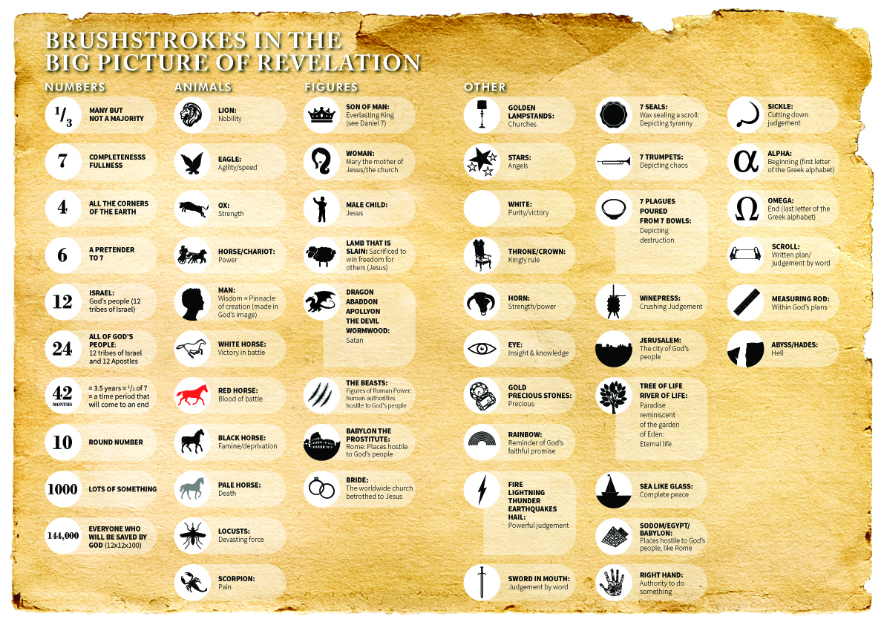
https://creekroad.org.au/cracking-code-reading-revelation/
Notes:
This would make a good Final Exam ☺
Marolyn Harbison notice all the sevens in Revelation
Genesis: 7 days of creation
Revelation: 7 churches; 7 golden lampstands (churches); 7 stars (angels); 7 horns on the Lamb; 7 eyes (Spirits of God); 7 seals; 7 trumpets; 7 thunders uttered their voices; 7 headed beast; angels with 7 last plagues; 7 golden bowls full of the wrath of God; 7 mountains; 7 kings
7 years of tribulation

Slide 24
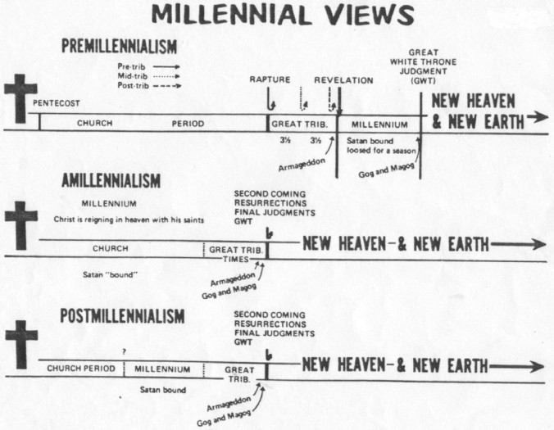

Slide 25
FINAL THOUGHTS...
1. A CALL TO COMMIT TO CHRIST!
Notes:
FINAL THOUGHTS:
1. A CALL TO COMMIT TO CHRIST (Rev 2-3)
Letters to the churches to endure and stand strong for Christ
Jesus’ INVITATION to come in and fellowship with them

Slide 26
Letters to the Seven Churches
Revelation 2-3

Slide 27
1:4
the seven churches that are in Asia:

Slide 28
Ways to interpret the Letters
Four possible audiences addressed in Revelation 2-3:
The literal churches
Saints “who have an ear to hear”
Seven Church types
Seven Church ages
Notes:
From:
Notes: https://truthnet.org/Christianity/revelation/Revelation2/
There are four audiences addressed in the book of Revelation:
1. The literal churches, 2. Saints “who have an ear”, 3. Seven Church types, 4. Seven Church ages
1. The literal churches
The first audience addressed in these letters is the literal church. These were literal churches with literal problems. Jesus in his comments first acknowledges the positive aspects (commendation) for each church. Except for the church of Laodicea, they had no commendation. Jesus also points out, where the churches lacked and their sin (condemnation). He warns them, what would follow, if they fail to correct the problem. The churches of Smyrna and Philadelphia received no condemnation, but were consoled for their suffering and weakness. The resurrected Jesus tells the failing churches what they need to do to correct their course (consultation). Jesus then promises the person who “Overcomes” an aspect of the life to come. He challenges the believer, to succeed, to “Overcome”, and achieve the challenge before them.
2. The saints “He who has an ear”
In addition to the physical churches, the letter also applies to every individual member of the church, especially those who have “Spiritual ears”. Jesus specifically addresses those who have an ear. The ear referred to here is not a physical ear, but a spiritual ear. Jesus is talking to the spiritual hearing, those who have a spiritual ear, to hear what the Spirit is saying to the churches. The contents of the letter as well as the comments are not limited to the “Seven Churches”, but the whole church.
The seven churches are merely models of what applies to the whole of Christianity. The church is made up of various types of believers, each like these churches dealing with issues. Some saints now suffer, some are rich, others have compromised their walk and their beliefs. To us, who have “Spiritual” ears, Jesus addresses this letter. Jesus holds out the promise, the challenge to the “Overcomer”.
3. Seven Church Types
Of the seven churches, no two are alike. Some of the churches have aspects of the other churches, but they deal with them in a different ways. Both Ephesus and Pergamum had Nicolaitans, one rejected them the other tolerated them. This variety in church types demonstrates an aspect seen from the founding of churches in individual cities, not every church is alike. Some churches are more obedient then others some thrive in the midst of persecution, others crumble with an abundance of wealth and power.
These seven church models are seven church-types; here Jesus gives the secret for a successful church. The letter to the seven churches is also a letter to seven types of churches. Churches today are faced with the same problems these first century churches faced. Jesus is telling the church how to deal with its problems.
Today there are huge church buildings and large congregations, filled with divisions over gay rights and abortion, what would Jesus’ position be on these issues? We can look at the model of Thyatira to find the answer. What about the suffering Christians in places where Christianity is persecuted by governments, like North Korea, Saudi Arabia and Iran? The church at Smyrna models the persecuted church, the letter is for them. If you were in a persecuted church, the message to Smyrna would be a message to your church.
4. The Seven Church Ages In chapter one, we see Jesus in the midst of “Seven Lampstands”. From Revelation 1:21, we learn, the seven lampstands represent the seven churches addressed in chapters 2 and 3. They represent the complete church. The progress of church history has a direct correlation to the events following the seven churches of Revelation chapters 2 and 3.
Starting with the Ephesus, the church founded by the Apostle Paul and administered by the Apostle John to the church of Laodicea, the wealthy lukewarm church, the history of the church is prophetically foretold. Jesus gives a “Prophetic foreshadowing” in the seven churches. From the churches founded by the apostles to the end of the age, Christ has a message for each church age imbedded in the message to the seven churches.
Following John, the last apostle, the Church underwent a period of persecution, until the time of Constantine, where the Roman Emperor himself professed to be a Christian. Christianity became popular within the Roman Empire. Constantine made allowances for pagan rites and customs. The correspondence between history and the letters to the seven churches, demonstrates their prophetic nature, foretelling the history and progression of church until the end of the age. This correspondence can be seen as the prophetic foreshadowing of the seven church ages.

Slide 29
An example of the “Seven Church Ages” interpretation
Notes:
From:
Chart: http://lafayettefirstumc.org/2015/05/18/seven-churches-of-revelation-sermon-series/
Notes: https://truthnet.org/Christianity/revelation/Revelation2/
There are four audiences addressed in the book of Revelation, the literal churches, saints who have an ear, seven church types and seven church ages.
1. The literal churches, 2. Saints, 3. Seven Church types, 4. Seven Church ages
1. The literal churches
The first audience addressed in these letters is the literal church. These were literal churches with literal problems. Jesus in his comments first acknowledges the positive aspects (commendation) for each church. Except for the church of Laodicea, they had no commendation. Jesus also points out, where the churches lacked and their sin (condemnation). He warns them, what would follow, if they fail to correct the problem. The churches of Smyrna and Philadelphia received no condemnation, but were consoled for their suffering and weakness. The resurrected Jesus tells the failing churches what they need to do to correct their course (consultation). Jesus then promises the person who “Overcomes” an aspect of the life to come. He challenges the believer, to succeed, to “Overcome”, and achieve the challenge before them.
2. The saints “He who has an ear”
In addition to the physical churches, the letter also applies to every individual member of the church, especially those who have “Spiritual ears”. Jesus specifically addresses those who have an ear. The ear referred to here is not a physical ear, but a spiritual ear. Jesus is talking to the spiritual hearing, those who have a spiritual ear, to hear what the Spirit is saying to the churches. The contents of the letter as well as the comments are not limited to the “Seven Churches”, but the whole church.
The seven churches are merely models of what applies to the whole of Christianity. The church is made up of various types of believers, each like these churches dealing with issues. Some saints now suffer, some are rich, others have compromised their walk and their beliefs. To us, who have “Spiritual” ears, Jesus addresses this letter. Jesus holds out the promise, the challenge to the “Overcomer”.
3. Seven Church Types
Of the seven churches, no two are alike. Some of the churches have aspects of the other churches, but they deal with them in a different ways. Both Ephesus and Pergamum had Nicolaitans, one rejected them the other tolerated them. This variety in church types demonstrates an aspect seen from the founding of churches in individual cities, not every church is alike. Some churches are more obedient then others some thrive in the midst of persecution, others crumble with an abundance of wealth and power.
These seven church models are seven church-types; here Jesus gives the secret for a successful church. The letter to the seven churches is also a letter to seven types of churches. Churches today are faced with the same problems these first century churches faced. Jesus is telling the church how to deal with its problems.
Today there are huge church buildings and large congregations, filled with divisions over gay rights and abortion, what would Jesus’ position be on these issues? We can look at the model of Thyatira to find the answer. What about the suffering Christians in places where Christianity is persecuted by governments, like North Korea, Saudi Arabia and Iran? The church at Smyrna models the persecuted church, the letter is for them. If you were in a persecuted church, the message to Smyrna would be a message to your church.
4. The Seven Church Ages In chapter one, we see Jesus in the midst of “Seven Lampstands”. From Revelation 1:21, we learn, the seven lampstands represent the seven churches addressed in chapters 2 and 3. They represent the complete church. The progress of church history has a direct correlation to the events following the seven churches of Revelation chapters 2 and 3.
Starting with the Ephesus, the church founded by the Apostle Paul and administered by the Apostle John to the church of Laodicea, the wealthy lukewarm church, the history of the church is prophetically foretold. Jesus gives a “Prophetic foreshadowing” in the seven churches. From the churches founded by the apostles to the end of the age, Christ has a message for each church age imbedded in the message to the seven churches.
Following John, the last apostle, the Church underwent a period of persecution, until the time of Constantine, where the Roman Emperor himself professed to be a Christian. Christianity became popular within the Roman Empire. Constantine made allowances for pagan rites and customs. The correspondence between history and the letters to the seven churches, demonstrates their prophetic nature, foretelling the history and progression of church until the end of the age. This correspondence can be seen as the prophetic foreshadowing of the seven church ages.

Slide 30
Revelation 3:20
What is interesting about this picture?
No doorknob on the outside of the door!
Jesus is on the outside of the church knocking to get in!
Notes:
PURPOSES OF REVELATION: ENCOURAGEMENT, CHALLENGE & EVANGELISM

Slide 31
FINAL THOUGHTS...
1. A CALL TO COMMIT TO CHRIST!
Notes:
FINAL THOUGHTS:
A CALL TO COMMIT TO CHRIST (Rev 2-3)
Letters to the churches to endure and stand strong for Christ
Jesus’ INVITATION to come in and fellowship with them

Slide 32
FINAL THOUGHTS...
2. A CALL TO WORSHIP
CHRIST!
Notes:
FINAL THOUGHTS:
2. A CALL TO WORSHIP CHRIST (Rev 5)
The Lion and the Lamb has overcome by His sacrifice
1. A CALL TO COMMIT TO CHRIST (Rev 2-3)
Letters to the churches to endure and stand strong for Christ
Jesus’ INVITATION to come in and fellowship with them

Slide 33
Revelation 5:1-5
4 Then I began to weep greatly because no one was found worthy to open the book or to look into it; 5 and one of the elders *said to me, “Stop weeping; behold, the Lion that is from the tribe of Judah, the Root of David, has overcome so as to open the book and its seven seals.”
Lion of Judah, Root of David = Gen 49; Isaiah 11; Jer 23; Rom 15
Overcome = From nike “to subdue” = aorist tense “once for all”
Notes:
Weep = continuous “noisy grief” = John knew it was important
Mixes the thoughts of the Messianic Davidic King and the Suffering Servant
Lion of Judah = Genesis 49 Jacob Blesses His Sons
…8 Judah, your brothers shall praise you. Your hand shall be on the necks of your enemies; your father’s sons shall bow down to you. 9 Judah is a young lion— my son, you return from the prey. Like a lion he crouches and lies down; like a lioness, who dares to rouse him? 10 The scepter will not depart from Judah, nor the staff from between his feet, until Shiloh comes and the allegiance of the nations is his. 11 He ties his donkey to the vine, his colt to the choicest branch. He washes his garments in wine, his robes in the blood of grapes. 12 His eyes are darker than wine, and his teeth are whiter than milk.
Root of Jesse = Isaiah 11:1-10
1 Then a shoot will spring from the stem of Jesse,
And a branch from his roots will bear fruit.
2 The Spirit of the Lord will rest on Him,
The spirit of wisdom and understanding,
The spirit of counsel and strength,
The spirit of knowledge and the fear of the Lord.
3 And He will delight in the fear of the Lord,
And He will not judge by what His eyes see,
Nor make a decision by what His ears hear;
4 But with righteousness He will judge the poor,
And decide with fairness for the afflicted of the earth;
And He will strike the earth with the rod of His mouth,
And with the breath of His lips He will slay the wicked.
5 Also righteousness will be the belt about His loins,
And faithfulness the belt about His waist.
6 And the wolf will dwell with the lamb,
And the leopard will lie down with the young goat,
And the calf and the young lion and the fatling together;
And a little boy will lead them.
7 Also the cow and the bear will graze,
Their young will lie down together,
And the lion will eat straw like the ox.
8 The nursing child will play by the hole of the cobra,
And the weaned child will put his hand on the viper’s den.
9 They will not hurt or destroy in all My holy mountain,
For the earth will be full of the knowledge of the Lord
As the waters cover the sea.
10 Then in that day
The nations will resort to the root of Jesse,
Who will stand as a signal for the peoples;
And His resting place will be glorious.
Jeremiah 23
4 I will raise up shepherds over them who will tend them, and they will no longer be afraid or dismayed, nor will any go missing, declares the LORD. 5 Behold, the days are coming, declares the LORD, when I will raise up for David a Righteous Branch, and He will reign wisely as king and administer justice and righteousness in the land. 6 In His days Judah will be saved, and Israel will dwell securely. And this is His name by which He will be called: The LORD Our Righteousness.…
Romans 15
11 And again: “Praise the Lord, all you Gentiles, and extol Him, all you peoples.” 12 And once more, Isaiah says: “The root of Jesse will appear, One who will arise to rule over the Gentiles; in Him the Gentiles will put their hope.” 13 Now may the God of hope fill you with all joy and peace as you believe in Him, so that you may overflow with hope by the power of the Holy Spirit.…

Slide 34
Lion of Judah

Slide 35
Revelation 5:6-7
6 And I saw between the throne (with the four living creatures) and the elders a Lamb standing, as if slain, having seven horns and seven eyes, which are the seven Spirits of God, sent out into all the earth. 7 And He came and took the book out of the right hand of Him who sat on the throne.
Lamb = 29 times in Rev
As if Slain = perfect tense (for all of time)
Notes:
Vs 5 John was told that the Lion has overcome! = Vs. 6 I saw a Lamb who had been slain! What a shocking sight!
Different word than other NT uses of “Lamb” (John 1:29, 36; Acts 8:32; 1 Peter 1:19)
!!! A slain lamb would be the weakest creature on earth, but is the only One powerful enough in heaven, earth, and under the earth to open the scroll!!!
Sacrificial lamb! Bears the marks of death, but is alive. “Slain” Greek word means “slaughtered; butchered”

Slide 36
Lamb of God
Notes:
https://www.foxnews.com/us/award-winning-lamb-under-investigation-for-performance-enhancing-drugs
An award-winning lamb is currently under investigation and may be stripped of its title after veterinarians at the Logan County Fair in Ohio found illegal drugs in its system.

Slide 37
FINAL THOUGHTS...
2. A CALL TO WORSHIP
CHRIST!
Notes:
FINAL THOUGHTS:
A CALL TO WORSHIP CHRIST (Rev 5)
The Lion and the Lamb has overcome by His sacrifice
A CALL TO COMMIT TO CHRIST (Rev 2-3)
Letters to the churches to endure and stand strong for Christ
Jesus’ INVITATION to come in and fellowship with them

Slide 38
FINAL THOUGHTS...
3. A CALL TO OVERCOME!
Notes:
FINAL THOUGHTS:
3. A CALL TO OVERCOME (Rev 12)
Be brave in the midst of persecution
They overcame him because of the blood of the Lamb and because of the word of their testimony, and they did not love their life even when faced with death.
1. A CALL TO COMMIT TO CHRIST (Rev 2-3)
Letters to the churches to endure and stand strong for Christ
Jesus’ INVITATION to come in and fellowship with them
2. A CALL TO WORSHIP CHRIST (Rev 5)
The Lion and the Lamb has overcome by His sacrifice

Slide 39
Revelation 12:10-11 Victory Cry
10 Then I heard a loud voice in heaven, saying,
“Now the salvation, and the power, and the kingdom of our God and the authority of His Christ have come, for the accuser of our brethren has been thrown down, he who accuses them before our God day and night. 11 And they overcame him because of the blood of the Lamb and because of the word of their testimony, and they did not love their life even when faced with death.
Notes:
Now... Have come... Salvation, power, kingdom, authority... Chapter 13 will talk about the authority of the Antichrist and the Beast and the False Prophet ➔ all are derived authority!!
Accuser = accuses them before God day and night!! Wearing out the courtroom!! But one day—NO MORE!!
Overcame = níkē, "victory" – ➔➔

Slide 40
Revelation 12:10-11 Victory Cry
Verse 11 ...
Overcame = níkē, ("victory“) - properly,
conquer; overcome; " 'to carry off the victory, come off victorious.' The verb implies a battle.
The blood of the Lamb
The Word of their testimony = μαρτυρίας : witness, evidence, testimony, reputation...
Did not love their life = No fear of death!!!
Notes:
Now... Have come... Salvation, power, kingdom, authority...
Overcame = níkē, "victory") – properly, conquer (overcome); " 'to carry off the victory, come off victorious.' The verb implies a battle"
By the blood of the Lamb = Not the blood of the dragon in forceful destruction of the dragon, but the Lamb shed His own blood... We stand on the Gospel... We win by aligning with Jesus... “Greater is He that is IN me than He that is in the world”
Because of the Word of their testimony = μαρτυρίας : witness, evidence, testimony, reputation... What defeats the accuser and deceiver is the TRUTH which sets men free!! The only weapon Jesus carries in Revelation is the sword in His mouth! We stand in the Authority of God’s Truth which set us free.
Did not love their life = No fear of death!!! No fear in Life!!! We love the Lord more than life itself!!! Satan cannot stand against that. Fear of death is one of his greatest weapons.... Man’s mortality drives him to extreme measures.

Slide 41
FINAL THOUGHTS...
3. A CALL TO OVERCOME!
Notes:
FINAL THOUGHTS:
3. A CALL TO OVERCOME (Rev 12)
Be brave in the midst of persecution
They overcame him because of the blood of the Lamb and because of the word of their testimony, and they did not love their life even when faced with death.
1. A CALL TO COMMIT TO CHRIST (Rev 2-3)
Letters to the churches to endure and stand strong for Christ
Jesus’ INVITATION to come in and fellowship with them
2. A CALL TO WORSHIP CHRIST (Rev 5)
The Lion and the Lamb has overcome by His sacrifice

Slide 42
FINAL THOUGHTS...
4. A CALL TO DEDICATION
And WISDOM!
Notes:
FINAL THOUGHTS:
4. A CALL TO DEDICATION AND WISDOM (Rev 13)
Mark of the beast vs. seal of the Living God
A WARNING AND AN ENCOURAGEMENT
1. A CALL TO COMMIT TO CHRIST (Rev 2-3)
Letters to the churches to endure and stand strong for Christ
Jesus’ INVITATION to come in and fellowship with them
2. A CALL TO WORSHIP CHRIST (Rev 5)
The Lion and the Lamb has overcome by His sacrifice
3. A CALL TO OVERCOME (Rev 12)
Be brave in the midst of persecution
They overcame him because of the blood of the Lamb and because of the word of their testimony, and they did not love their life even when faced with death.

Slide 43
Revelation 13:17-18 His Number is 666
17 and he provides that no one will be able to buy or to sell, except the one who has the mark, either the name of the beast or the number of his name. 18 Here is wisdom. Let him who has understanding calculate the number of the beast, for the number is that of a man; and his number is six hundred and sixty-six.
What is the “mark of the beast”????
Notes:
Name of the beast or the number of his name
WISDOM... UNDERSTANDING...
These are Gifts of God for His children... granted to believers by the power of the Holy Spirit!!
WE WILL KNOW!!

Slide 44
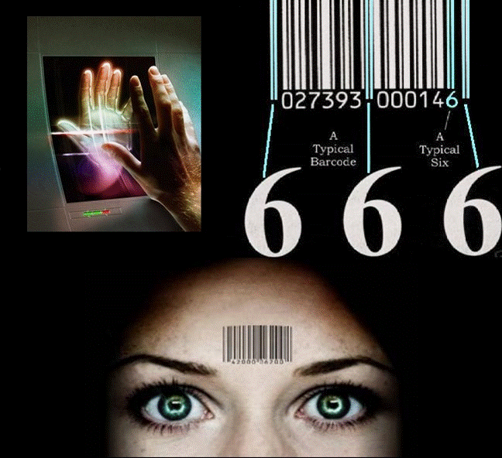
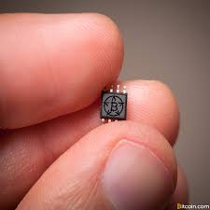
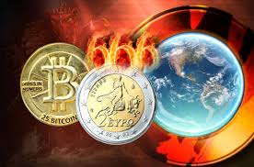
What is the “mark of the beast”????
Notes:
We don’t know!!! But we should not be afraid!!!
It will be a man thing... But we are God’s people!!

Slide 45
Revelation 13:8 His Number is 666
18 ...calculate the number of the beast,
for the number is that of a man; and his number is
six hundred and sixty-six.
Number of man
Falls short of the Divine = 777
Jesus = 888
Requires worship and blasphemy!!
DON’T BE AFRAID!!!
Notes:
CALCULATE THE NUMBER = THAT OF A MAN = 666
It will be a man thing... But we are God’s people!!
Involves false worship and blasphemy!!
Tyndale, Morris
Many numerical attempts have been made to match the number 666 to numerology (Nero, Roman empire, Hitler, etc.) by utilizing Hebrew, or Greek letters for numbers... BUT...
It is possible that such solutions are on the wrong lines and that we should understand the expression purely in terms of the symbolism of numbers. If we take the sum of the values represented by the letters of the name Iēsous, the Greek name ‘Jesus’, it comes to 888; each digit is one more than seven, the perfect number. But 666 yields the opposite phenomenon, for each digit falls short. The number may be meant to indicate not an individual, but a persistent falling short. All the more is this likely to be correct if we translate ‘it is the number of man’ rather than ‘a man’. John will then be saying that unregenerate man is persistently evil. He bears the mark of the beast [Vol 20: Rev, p. 169] in all he does. Civilization without Christ is necessarily under the dominion of the evil one.

Slide 46
We are already sealed ...
Rev 7:1-8 Do not harm the earth or the sea or the trees until we have sealed the bond-servants of our God on their foreheads. (144,00 sealed)
Rev 9:4 the locusts were told not to hurt the grass of the earth, nor any green thing, nor any tree, but only the men who do not have the seal of God on their foreheads.
Rev 14:1 Then I looked, and behold, the Lamb was standing on Mount Zion, and with Him 144,000, having His Name and the Name of His Father written on their foreheads.
Notes:
CALCULATE THE NUMBER = THAT OF A MAN = 666
Number of man
Falls short of the Divine = 777
requires worship and blasphemy!!
We are already sealed ...
Rev 7:1-8 Do not harm the earth or the sea or the trees until we have sealed the bond-servants of our God on their foreheads. (144,00 sealed)
Rev 9:4 the locusts were told not to hurt the grass of the earth, nor any green thing, nor any tree, but only the men who do not have the seal of God on their foreheads.
Rev 14:1 Then I looked, and behold, the Lamb was standing on Mount Zion, and with Him 144,000, having His Name and the Name of His Father written on ttheir foreheads.
Rev 14:9-10 Then another angel, a third one, followed them, saying with a lound voice, “If anyone worships the beast and his image, and receives a mark on his forehead or on his hand, he also will drink of the wine of the wrath of God, which is mixed in full strength in the cup of His anger; and he will be tormented with fire and brimstone in the presence of the holy angels and in the presence of the Lamb....
Rev 20:4 thrones in the millennial kingdom for those who did not worship the beast... nor received the mark on their foreheads or hands
Rev 22:4 they will see His face, and His name will be on their foreheads.

Slide 47
FINAL THOUGHTS...
4. A CALL TO DEDICATION
And WISDOM!
Notes:
FINAL THOUGHTS:
4. A CALL TO DEDICATION AND WISDOM (Rev 13)
Mark of the beast vs. seal of the Living God
A WARNING AND AN ENCOURAGEMENT
Worship only God thru Christ. Don’t give your ultimate allegiance to man’s kingdoms.
1. A CALL TO COMMIT TO CHRIST (Rev 2-3)
Letters to the churches to endure and stand strong for Christ
Jesus’ INVITATION to come in and fellowship with them
2. A CALL TO WORSHIP CHRIST (Rev 5)
The Lion and the Lamb has overcome by His sacrifice
3. A CALL TO OVERCOME (Rev 12)
Be brave in the midst of persecution
They overcame him because of the blood of the Lamb and because of the word of their testimony, and they did not love their life even when faced with death.

Slide 48
FINAL THOUGHTS...
5. A CALL TO CELEBRATE
THE VICTORY OF CHRIST!
Notes:
FINAL THOUGHTS:
5. A CALL TO CELEBRATE THE VICTORY OF CHRIST (Rev 19)
Hallelujah Chorus
The King on the White Horse
1. A CALL TO COMMIT TO CHRIST (Rev 2-3)
Letters to the churches to endure and stand strong for Christ
Jesus’ INVITATION to come in and fellowship with them
2. A CALL TO WORSHIP CHRIST (Rev 5)
The Lion and the Lamb has overcome by His sacrifice
3. A CALL TO OVERCOME (Rev 12)
Be brave in the midst of persecution
They overcame him because of the blood of the Lamb and because of the word of their testimony, and they did not love their life even when faced with death.
4. A CALL TO DEDICATION AND WISDOM (Rev 13)
Mark of the beast vs. seal of the Living God

Slide 49
Revelation 19:1-6 cont. Hallelujah Chorus
6 Then I heard something like the voice of a great multitude and like the sound of many waters, and like the sound of mighty peals of thunder, saying,
“Hallelujah! For the Lord our God, the Almighty, reigns.
Notes:
HALLELUJAH CHORUS (from Handel’s Messiah):
“Hallelujah! For the Lord our God, the Almighty, reigns.
Reigns ➔ aorist (could be inceptive meaning He has begun to reign... It has started)

Slide 50
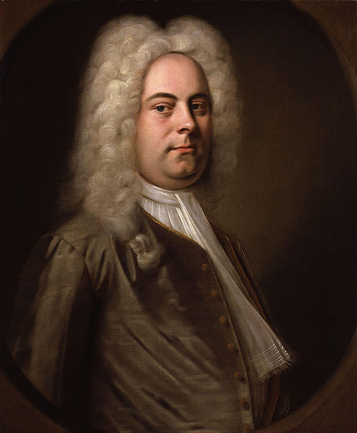
Revelation 19:6 KJV Hallelujah Chorus
Hallelujah!
for the Lord God omnipotent reigneth.
Royal Choral Society at the Royal Albert Hall
Notes:
HALLELUJAH CHORUS (from Handel’s Messiah):
“Hallelujah! For the Lord our God, the Almighty, reigns.
Royal Choral Society at the Royal Albert Hall
https://www.youtube.com/watch?v=IUZEtVbJT5c

Slide 51
Revelation 19:11-14 cont. The Word of God
11 And I saw heaven opened, and behold, a white horse, and He who sat on it is called Faithful and True, and in righteousness He judges and wages war. 12 His eyes are a flame of fire, and on His head are many crowns; and He has a name written on Him which no one knows except Himself. 13 He is clothed with a robe dipped in blood, and His name is called The Word of God. 14 And the armies which are in heaven, clothed in fine linen, white and clean, were following Him on white horses.
Notes:
14 And the armies which are in heaven, clothed in fine linen, white and clean, were following Him on white horses.
?? Angels?? (the heavenly host = armies of angels) ??
?? Believers?? (fine linen in vs 8 was the righteous acts of the saints) ??
*** Glen Blackmon’s favorite passage... Before he goes out to do battle as a police officer.

Slide 52
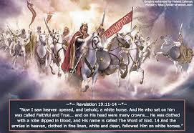

Slide 53
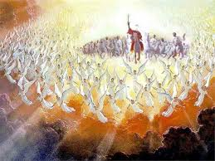

Slide 54
Revelation 19:15-16 King of Kings, Lord of Lords
15 From His mouth comes a sharp sword, so that with it He may strike down the nations, and He will rule them with a rod of iron; and He treads the wine press of the fierce wrath of God, the Almighty. 16 And on His robe and on His thigh He has a name written: “KING OF KINGS, AND LORD OF LORDS.”
Notes:
15 From His mouth comes a sharp sword, so that with it He may strike down the nations, ➔
the army rides with Him, but no one gets to fight!!!
He slays all of his enemies with a sword from His mouth ➔ POWER of the Word of God!!!
and He will rule them with a rod of iron;
and He treads the wine press of the fierce wrath of God, the Almighty.
16 And on His robe and on His thigh He has a name written: “KING OF KINGS, AND LORD OF LORDS.” (more of Handel’s Messiah Hallelujah Chorus)

Slide 55
FINAL THOUGHTS...
5. A CALL TO CELEBRATE
THE VICTORY OF CHRIST!
Notes:
FINAL THOUGHTS:
5. A CALL TO CELEBRATE THE VICTORY OF CHRIST (Rev 19)
Hallelujah Chorus
The King on the White Horse
1. A CALL TO COMMIT TO CHRIST (Rev 2-3)
Letters to the churches to endure and stand strong for Christ
Jesus’ INVITATION to come in and fellowship with them
2. A CALL TO WORSHIP CHRIST (Rev 5)
The Lion and the Lamb has overcome by His sacrifice
3. A CALL TO OVERCOME (Rev 12)
Be brave in the midst of persecution
They overcame him because of the blood of the Lamb and because of the word of their testimony, and they did not love their life even when faced with death.
4. A CALL TO DEDICATION AND WISDOM (Rev 13)
Mark of the beast vs. seal of the Living God

Slide 56
FINAL THOUGHTS...
6. A CALL TO SALVATION!
Notes:
FINAL THOUGHTS:
6. A CALL TO SALVATION (Rev 20)
Great White Throne Judgment
The Lamb’s Book of Life
1. A CALL TO COMMIT TO CHRIST (Rev 2-3)
Letters to the churches to endure and stand strong for Christ
Jesus’ INVITATION to come in and fellowship with them
2. A CALL TO WORSHIP CHRIST (Rev 5)
The Lion and the Lamb has overcome by His sacrifice
3. A CALL TO OVERCOME (Rev 12)
Be brave in the midst of persecution
They overcame him because of the blood of the Lamb and because of the word of their testimony, and they did not love their life even when faced with death.
4. A CALL TO DEDICATION AND WISDOM (Rev 13)
Mark of the beast vs. seal of the Living God
5. A CALL TO CELEBRATE THE VICTORY OF CHRIST (Rev 19)
Hallelujah Chorus
The King on the White Horse

Slide 57
Revelation 20:11-15 The Great White Throne Judgment
11 Then I saw a great white throne and Him who sat upon it, from whose presence earth and heaven fled, and no place was found for them. 12 And I saw the dead, the great and the small, standing before the throne, and books were opened; and another book was opened, which is the book of life; and the dead were judged from the things which were written in the books, according to their deeds.
Notes:
Great White Throne Judgment
All people?
Book of Life trumps what is written in the books of deeds
Just the unbelievers?
??? Separate BEMA SEAT ?? (Christians have a judgment of works at the judgment seat [bema] of Christ 2 Corinthians 5:10: For we must all appear before the judgment seat of Christ, so that each one may receive what is due for what he has done in the body, whether good or evil.)
https://www.gotquestions.org/great-white-throne-judgment.html
Some Christians believe that the Scriptures reveal three different judgments to come. The first is the judgment of the sheep and the goats or a judgment of the nations (Matthew 25:31-36). This takes place after the tribulation period but prior to the millennium; its purpose is to determine who will enter the millennial kingdom. The second is a judgment of believers’ works, often referred to as the “judgment seat [bema] of Christ” (2 Corinthians 5:10). At this judgment, Christians will receive degrees of reward for their works or service to God. The third is the great white throne judgment at the end of the millennium (Revelation 20:11-15). This is the judgment of unbelievers in which they are judged according to their works and sentenced to everlasting punishment in the lake of fire. Other Christians believe that all three of these judgments speak of the same final judgment, not of three separate judgments. In other words, the great white throne judgment in Revelation 20:11-15 will be the time that believers and unbelievers alike are judged. Those whose names are found in the book of life will be judged for their deeds in order to determine the rewards they will receive or lose. Those whose names are not in the book of life will be judged according to their deeds to determine the degree of punishment they will receive in the lake of fire. Those who hold this view believe that Matthew 25:31-46 is another description of what takes place at the great white throne judgment. They point to the fact that the result of this judgment is the same as what is seen after the great white throne judgment in Revelation 20:11-15. The sheep (believers) enter into eternal life, while the goats (unbelievers) are cast into “eternal punishment” (Matthew 25:46). Whichever view one holds of the great white throne judgment, it is important to never lose sight of the facts concerning the coming judgment(s). First, Jesus Christ will be the judge, all unbelievers will be judged by Christ, and they will be punished according to the works they have done. The Bible is very clear that unbelievers are storing up wrath against themselves (Romans 2:5) and that God will “give to each person according to what he has done” (Romans 2:6). Believers will also be judged by Christ, but since Christ’s righteousness has been imputed to us and our names are written in the book of life, we will be rewarded, but not punished, according to our deeds. Romans 14:10-12 says that we will all stand before the judgment seat of Christ and that each one of us will give an account to God.

Slide 58
Revelation 20:11-15 The Great White Throne Judgment
13 And the sea gave up the dead who were in it, and Death and Hades gave up the dead who were in them; and they were judged, each one of them according to their deeds. 14 Then Death and Hades were thrown into the lake of fire. This is the second death, the lake of fire. 15 And if anyone’s name was not found written in the book of life, he was thrown into the lake of fire.
Notes:
God will cast Satan, the deceiver, into "the lake of fire" that He previously prepared for the devil and his angels (Matt. 25:41).
Death and Hades ➔ final enemies of mankind (1 Corinthians 15 “death is swallowed up in victory!”)
NO MORE DEATH !!!!
ETERNAL LIFE !!!
But only for those whose names are found written in the book of life ! (Lamb’s Book of Life, OT: book of the living)

Slide 59
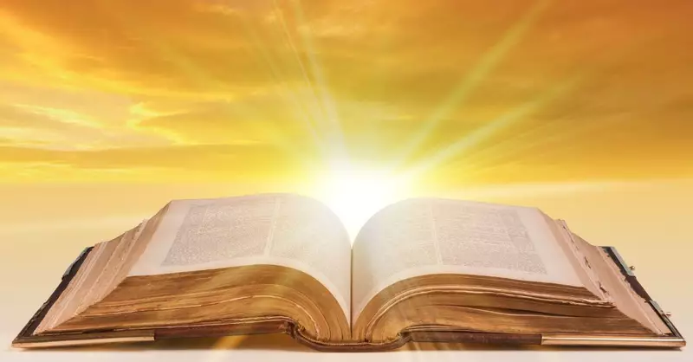
Is your name written in the Lamb’s Book of Life?
Notes:
The Lamb’s Book of Life
Luke 10:20 ESV
Nevertheless, do not rejoice in this, that the spirits are subject to you, but rejoice that your names are written in heaven.”
Revelation 13:8 ESV
And all who dwell on earth will worship it, everyone whose name has not been written before the foundation of the world in the book of life of the Lamb who was slain.
Revelation 21:27 ESV
But nothing unclean will ever enter it, nor anyone who does what is detestable or false, but only those who are written in the Lamb's book of life.
IS YOUR NAME WRITTEN IN THE LAMB’S BOOK OF LIFE: CALL OUT TO JESUS NOW... ASK HIS FORGIVENESS AND CLEANSING... ACCEPT HIS LORDSHIP AND MERCY... BE SET FREE FROM YOUR SLAVERY TO SATAN, SELF, AND SIN... YIELD YOUR HEART TO THE FATHER...

Slide 60
FINAL THOUGHTS...
6. A CALL TO SALVATION!
Notes:
FINAL THOUGHTS:
6. A CALL TO SALVATION (Rev 20)
Great White Throne Judgment
The Lamb’s Book of Life
1. A CALL TO COMMIT TO CHRIST (Rev 2-3)
Letters to the churches to endure and stand strong for Christ
Jesus’ INVITATION to come in and fellowship with them
2. A CALL TO WORSHIP CHRIST (Rev 5)
The Lion and the Lamb has overcome by His sacrifice
3. A CALL TO OVERCOME (Rev 12)
Be brave in the midst of persecution
They overcame him because of the blood of the Lamb and because of the word of their testimony, and they did not love their life even when faced with death.
4. A CALL TO DEDICATION AND WISDOM (Rev 13)
Mark of the beast vs. seal of the Living God
5. A CALL TO CELEBRATE THE VICTORY OF CHRIST (Rev 19)
Hallelujah Chorus
The King on the White Horse

Slide 61
FINAL THOUGHTS...
7. A CALL TO HOPE!
Notes:
FINAL THOUGHTS:
7. A CALL TO HOPE (Rev 21-22)
New heaven and earth
New Jerusalem
God in the midst!
1. A CALL TO COMMIT TO CHRIST (Rev 2-3)
Letters to the churches to endure and stand strong for Christ
Jesus’ INVITATION to come in and fellowship with them
2. A CALL TO WORSHIP CHRIST (Rev 5)
The Lion and the Lamb has overcome by His sacrifice
3. A CALL TO OVERCOME (Rev 12)
Be brave in the midst of persecution
They overcame him because of the blood of the Lamb and because of the word of their testimony, and they did not love their life even when faced with death.
4. A CALL TO DEDICATION AND WISDOM (Rev 13)
Mark of the beast vs. seal of the Living God
5. A CALL TO CELEBRATE THE VICTORY OF CHRIST (Rev 19)
Hallelujah Chorus
The King on the White Horse
6. A CALL TO SALVATION (Rev 20)
Great White Throne Judgment
The Lamb’s Book of Life

Slide 62
Revelation 21:1-4 The Presence of God
1 Then I saw a new heaven and a new earth; for the first heaven and the first earth passed away, and there is no longer any sea. 2 And I saw the holy city, new Jerusalem, coming down out of heaven from God, prepared as a bride adorned for her husband.
Notes:
New Jerusalem ➔ contrasted with Babylon, the great whore !!
No longer any sea == the sea was a symbol of separation and danger ! ALSO. No need for sea commerce... Sustainable through tree of life and fresh water coming from the throne and light from the Lord and the Lamb (Revelation 22:1-2) !

Slide 63
Revelation 21:1-4 The Presence of God
3 And I heard a loud voice from the throne, saying, “Behold, the tabernacle of God is among the people, and He will dwell among them, and they shall be His people, and God Himself will be among them, 4 and He will wipe away every tear from their eyes; and there will no longer be any death; there will no longer be any mourning, or crying, or pain; the first things have passed away.”
Notes:
ADVENT MESSAGE: threefold COMING of Christ:
Jesus came and dwelt among us ➔ Immanuel == God with us
PURPOSE: TO SAVE SINNERS
Jesus came through indwelling Holy Spirit ➔ God in us (Colossians 1 Christ in you, the hope of glory == mystery)
PURPOSE: TO SANCTIFY SAINTS AND CONVICT OF SIN, RIGHTEOUSNESS AND JUDGMENT
Jesus will come again to take us to Himself (John 14: where I am, you will be also) ➔ Us with God == He will dwell among us and be our tabernacle (dwelling place)
PURPOSE: TO SETTLE US IN HIS PRESENCE == IN HIS HOUSEHOLD
God Himself will be among them, 4 and
He will wipe away every tear from their eyes; == NO TEARS IN HEAVEN OR JUST COMFORTED IMMEDIATELY WHEN THEY FALL???
and there will no longer be
any death;
any mourning, or
crying, or
pain;
the first things have passed away.” (FIRST THINGS ➔ TEMPORARY) ... Again, “so be brave in face of persecution”

Slide 64
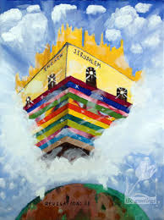
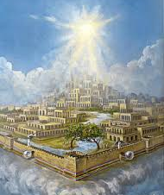
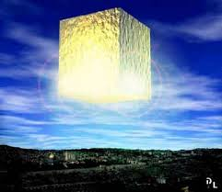
Notes:
Newport (305) “God takes Israel and the church through the stages of the earthly Jerusalem, the heavenly Jerusalem, and the new Jerusalem in order to teach them that humanity’s dream of a holy city is not a delusion. Rather, the holy city is the goal toward which redeemed people, salvation history, and the whole creation move.”

Slide 65
FINAL THOUGHTS...
7. A CALL TO HOPE!
Notes:
FINAL THOUGHTS:
7. A CALL TO HOPE (Rev 21-22)
New heaven and earth
New Jerusalem
God in the midst!
1. A CALL TO COMMIT TO CHRIST (Rev 2-3)
Letters to the churches to endure and stand strong for Christ
Jesus’ INVITATION to come in and fellowship with them
2. A CALL TO WORSHIP CHRIST (Rev 5)
The Lion and the Lamb has overcome by His sacrifice
3. A CALL TO OVERCOME (Rev 12)
Be brave in the midst of persecution
They overcame him because of the blood of the Lamb and because of the word of their testimony, and they did not love their life even when faced with death.
4. A CALL TO DEDICATION AND WISDOM (Rev 13)
Mark of the beast vs. seal of the Living God
5. A CALL TO CELEBRATE THE VICTORY OF CHRIST (Rev 19)
Hallelujah Chorus
The King on the White Horse
6. A CALL TO SALVATION (Rev 20)
Great White Throne Judgment
The Lamb’s Book of Life

Slide 66
FINAL THOUGHTS...
8. A CALL TO PRAYER AND EVANGELISM ➔ COME!
Notes:
FINAL THOUGHTS: ☺ Marolyn ➔ I guess I should have stopped at 7 thoughts... But I didn’t!!!
8. A CALL TO PRAYER AND EVANGELISM (Rev 22)
Spirit and Bride (church) say: “Come.” Evangelistic sermon!!!
Amen. Come Lord Jesus. Evangelical prayer!!!
Come ➔ The first and last word of the church. Our message and our prayer!!!
1. A CALL TO COMMIT TO CHRIST (Rev 2-3)
Letters to the churches to endure and stand strong for Christ
Jesus’ INVITATION to come in and fellowship with them
2. A CALL TO WORSHIP CHRIST (Rev 5)
The Lion and the Lamb has overcome by His sacrifice
3. A CALL TO OVERCOME (Rev 12)
Be brave in the midst of persecution
They overcame him because of the blood of the Lamb and because of the word of their testimony, and they did not love their life even when faced with death.
4. A CALL TO DEDICATION AND WISDOM (Rev 13)
Mark of the beast vs. seal of the Living God
5. A CALL TO CELEBRATE THE VICTORY OF CHRIST (Rev 19)
Hallelujah Chorus
The King on the White Horse
6. A CALL TO SALVATION (Rev 20)
Great White Throne Judgment
The Lamb’s Book of Life
7. A CALL TO HOPE (Rev 21-22)
New heaven and earth
New Jerusalem
God in the midst!

Slide 67
Revelation 22:17 Let the Thirsty Come
17 The Spirit and the bride say, “Come.” And let the one who hears say, “Come.” And let the one who is thirsty come; let the one who desires, take the water of life without cost.
Notes:
Spirit and Bride (church) say: “Come.” Evangelistic sermon!!!
The one who hears = believes the Gospel and is converted ➔ then joins in sharing the Good News: “Come to Jesus”
The one who is thirsty = Isaiah 55:1 "Come, all you who are thirsty, come to the waters; and you without money, come, buy, and eat! Come, buy wine and milk without money and without cost!
The one who desires =
Take the water of life without cost = still available as long as the end has not come!!!
John 7:37 In the last day, that great day of the feast, Jesus stood and cried, saying, If any man thirst, let him come unto me, and drink.
Threefold “come/let him come” present imperative ➔ urgency and availability until the end

Slide 68
Revelation 22:20-21 Maranatha!
20 He who testifies to these things says, “Yes, I am coming quickly.”
Amen. Come, Lord Jesus.
21 The grace of the Lord Jesus be with all. Amen.
Notes:
Jesus : Yes, I am coming quickly. (SOON)
Our prayer: Aramaic: Maranatha ➔ Come Lord Jesus
1 Corinthians 16:22
21 The greeting is in my own hand—that of Paul. 22 If anyone does not love the Lord, he is to be accursed. Maranatha! 23 The grace of the Lord Jesus be with you. 24 My love be with you all in Christ Jesus. Amen.
NEWPORT: we live with two great prayers on our lips:
Thy Kingdom come, Thy will be done on earth as it is in heaven
Amen. Come Lord Jesus.
A prayer for today and a prayer for tomorrow!

Slide 69
Revelation 22:20-21 Maranatha!
Two Great Prayers on the lips of believers...
Thy Kingdom come, Thy will be done on earth as it is in heaven
A prayer for God’s movement in the world TODAY
Amen. Come Lord Jesus.
A prayer of anticipation and HOPE for TOMORROW
Notes:
Jesus : Yes, I am coming quickly. (SOON)
Our prayer: Aramaic: Maranatha ➔ Come Lord Jesus
1 Corinthians 16:22
21 The greeting is in my own hand—that of Paul. 22 If anyone does not love the Lord, he is to be accursed. Maranatha! 23 The grace of the Lord Jesus be with you. 24 My love be with you all in Christ Jesus. Amen.
NEWPORT: we live with two great prayers on our lips:
Thy Kingdom come, Thy will be done on earth as it is in heaven
Amen. Come Lord Jesus.
A prayer for today and a prayer for tomorrow!

Slide 70
FINAL THOUGHTS...
8. A CALL TO PRAYER AND EVANGELISM ➔ COME!
Notes:
FINAL THOUGHTS:
8. A CALL TO PRAYER AND EVANGELISM (Rev 22)
Spirit and Bride (church) say: “Come.” Evangelistic sermon!!!
Amen. Come Lord Jesus. Evangelical prayer!!!
Come ➔ The first and last word of the church. Our message and our prayer!!!
1. A CALL TO COMMIT TO CHRIST (Rev 2-3)
Letters to the churches to endure and stand strong for Christ
Jesus’ INVITATION to come in and fellowship with them
2. A CALL TO WORSHIP CHRIST (Rev 5)
The Lion and the Lamb has overcome by His sacrifice
3. A CALL TO OVERCOME (Rev 12)
Be brave in the midst of persecution
They overcame him because of the blood of the Lamb and because of the word of their testimony, and they did not love their life even when faced with death.
4. A CALL TO DEDICATION AND WISDOM (Rev 13)
Mark of the beast vs. seal of the Living God
5. A CALL TO CELEBRATE THE VICTORY OF CHRIST (Rev 19)
Hallelujah Chorus
The King on the White Horse
6. A CALL TO SALVATION (Rev 20)
Great White Throne Judgment
The Lamb’s Book of Life
7. A CALL TO HOPE (Rev 21-22)
New heaven and earth
New Jerusalem
God in the midst!

Slide 71
FINAL THOUGHTS... Revelation is...
1. A CALL TO COMMIT TO CHRIST (Rev 2-3)
2. A CALL TO WORSHIP CHRIST (Rev 5)
3. A CALL TO OVERCOME (Rev 12)
4. A CALL TO DEDICATION AND WISDOM (Rev 13)
5. A CALL TO CELEBRATE THE VICTORY OF CHRIST
(Rev 19)
6. A CALL TO SALVATION (Rev 20)
7. A CALL TO HOPE (Rev 21-22)
8. A CALL TO PRAYER AND EVANGELISM ➔ COME!
Notes:
FINAL THOUGHTS:
8. A CALL TO PRAYER AND EVANGELISM (Rev 22)
Spirit and Bride (church) say: “Come.” Evangelistic sermon!!!
Amen. Come Lord Jesus. Evangelical prayer!!!
Come ➔ The first and last word of the church. Our message and our prayer!!!
1. A CALL TO COMMIT TO CHRIST (Rev 2-3)
Letters to the churches to endure and stand strong for Christ
Jesus’ INVITATION to come in and fellowship with them
2. A CALL TO WORSHIP CHRIST (Rev 5)
The Lion and the Lamb has overcome by His sacrifice
3. A CALL TO OVERCOME (Rev 12)
Be brave in the midst of persecution
They overcame him because of the blood of the Lamb and because of the word of their testimony, and they did not love their life even when faced with death.
4. A CALL TO DEDICATION AND WISDOM (Rev 13)
Mark of the beast vs. seal of the Living God
5. A CALL TO CELEBRATE THE VICTORY OF CHRIST (Rev 19)
Hallelujah Chorus
The King on the White Horse
6. A CALL TO SALVATION (Rev 20)
Great White Throne Judgment
The Lamb’s Book of Life
7. A CALL TO HOPE (Rev 21-22)
New heaven and earth
New Jerusalem
God in the midst!

